Slide 1
SmartSAT
PRODUCT & SALES 01
Digital SAT preparation
with 24×7 AI support
Mock exams, personalized mistake review
and a 3,200-word vocabulary system.
For students, families and educators
Illustrative scene
smartsat.us
Notes:
Sources: CEO product brief 2026-10-12; /Users/bingliu/Documents/Codex/output/pdf/SmartSAT_White_Paper_CN_2026_09_v7_with_product_screenshots.pdf, pages4,6-8. Product destination https://smartsat.us. Image source: site-owned built-in image_gen assets, provenance /Users/bingliu/Documents/Codex/Sites/smartsat.co/docs/menu-background-assets.json. Illustrative scene, not a real student testimonial or product screenshot.

Slide 2
SmartSAT
PRODUCT & SALES 02
A clearer next step after every practice session
Students
Understand what went wrong
and which concept to practise next.
Parents
See learning activity and progress
without guessing how study time went.
Educators
Use targeted practice to support
individual learning needs.
Illustrative scene
smartsat.us
Notes:
Sources: /Users/bingliu/Documents/Codex/output/pdf/SmartSAT_White_Paper_CN_2026_09_v7_with_product_screenshots.pdf, pages6-8,15,17. /Users/bingliu/Documents/Codex/Sites/smartsat.co/public/whitepapers/SmartSAT_Precision_Prep.pdf, page10. Audience needs are source descriptions, not measured survey results. Example Grade11 persona1250/1400+ is hypothetical and not used as real outcome data. Image source: site-owned built-in image_gen assets, provenance /Users/bingliu/Documents/Codex/Sites/smartsat.co/docs/menu-background-assets.json. Illustrative scene, not a real student testimonial or product screenshot.

Slide 3
SmartSAT
PRODUCT & SALES 03
Four priorities in one preparation product
Digital SAT
Mock exams to identify gaps
24×7
One-to-one AI mistake-notebook tutoring
3,200
SAT vocabulary words for structured practice
150 points
Average improvement target
Company target. Individual results vary.
smartsat.us
Notes:
Sources: CEO brief2026-10-12; /Users/bingliu/Documents/Codex/output/pdf/SmartSAT_White_Paper_CN_2026_09_v7_with_product_screenshots.pdf, pages4,8,41; /Users/bingliu/Documents/Codex/Sites/smartsat.co/public/whitepapers/SmartSAT_AGI_SAT_Revolution.pdf, pages3,6; /Users/bingliu/Documents/Codex/Sites/smartsat.co/public/whitepapers/SmartSAT_Precision_Prep.pdf, page9. 150points is historical expected average improvement target. No empirical cohort evidence supplied. Keep disclosure visible. 24×7 refers to AI support, not live-human staffing. Vocabulary system size source-backed, not independently counted against live DB.

Slide 4
SmartSAT
PRODUCT & SALES 04
The SmartSAT learning workflow
01
Diagnose
Find a starting point and weak concepts.
02
Practise
Take mock exams and review missed items.
03
Understand
Discuss mistakes with AI explanations.
04
Re-test
Check understanding with related questions.
05
Track
Review progress and choose the next task.
Illustrative scene
smartsat.us
Notes:
Sources: /Users/bingliu/Documents/Codex/Sites/smartsat.co/public/whitepapers/SmartSAT_AGI_SAT_Revolution.pdf, pages5-6; /Users/bingliu/Documents/Codex/output/pdf/SmartSAT_White_Paper_CN_2026_09_v7_with_product_screenshots.pdf, pages6,13,28-29; /Users/bingliu/Documents/Codex/Sites/smartsat.co/public/whitepapers/SmartSAT_Precision_Prep.pdf, pages6-8. Workflow is explanatory product description, not fabricated score progression. Image source: site-owned built-in image_gen assets, provenance /Users/bingliu/Documents/Codex/Sites/smartsat.co/docs/menu-background-assets.json. Illustrative scene, not a real student testimonial or product screenshot.

Slide 5
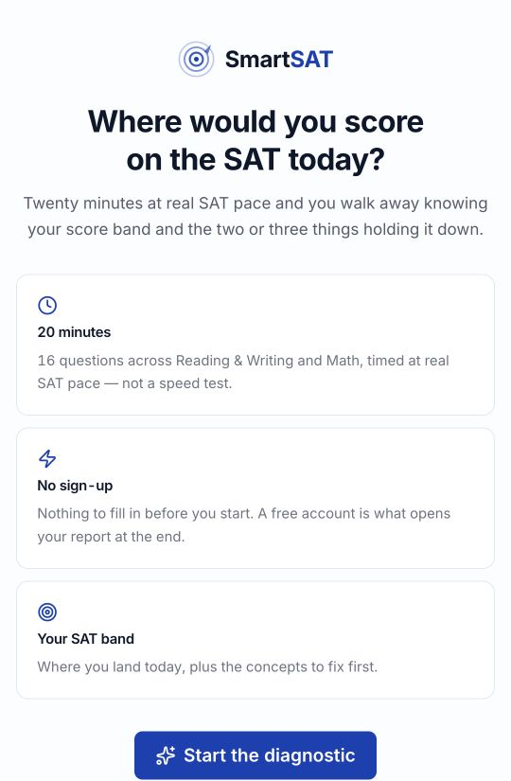
SmartSAT
PRODUCT & SALES 05
A free diagnostic before registration
16 questions
Reading & Writing and Math
at real SAT pace.
20-minute diagnostic
Start without an account.
Register to open your report.
Short on time? Stop after six answers.
A shorter test gives a wider estimated range.
smartsat.us
Notes:
Current production screenshot2026-10-12: /Users/bingliu/Documents/Codex/SmartSAT-Marketing-2026/videos/source-frames/02-diagnostic-start.png. https://smartsat.us/diagnostic. Public bundle https://smartsat.us/assets/index-Cu5UdBhp.js:20minutes16questions. diagnostic-he4y98N8.js:const xe=6 and Stop here confirmation, report requires account. Six-answer report may have wider score range than full diagnostic. Coordinating task actually completed six anonymous answers, early-stop confirmation and the reportgate on2026-10-12. NewStudent registration awaits action-timeTerms/Privacyapproval. Fullclaimedreport notverified. This screenshot proves the current entrypage only.

Slide 6
SmartSAT
PRODUCT & SALES 06
Digital SAT mock exams
Practise Reading & Writing and Math
in the Digital SAT format.
A useful report after the test
Review score estimates, performance
and missed concepts before the next session.
SmartSAT is an independent preparation service.
Illustrative scene
smartsat.us
Notes:
Sources: /Users/bingliu/Documents/Codex/output/pdf/SmartSAT_White_Paper_CN_2026_09_v7_with_product_screenshots.pdf, pages6,8,22; https://smartsat.us/assets/PricingCards-COlBQF9d.js. Independent preparation, not official CollegeBoard exams or affiliation. Source-backed product description, current complete exam execution not represented by this illustration. Image source: site-owned built-in image_gen assets, provenance /Users/bingliu/Documents/Codex/Sites/smartsat.co/docs/menu-background-assets.json. Illustrative scene, not a real student testimonial or product screenshot.

Slide 7
SmartSAT
PRODUCT & SALES 07
AI help inside the mistake notebook
24×7
One-to-one explanations
for the mistakes you need to fix.
Review. Explain. Practise again.
Build understanding with related questions.
Three correct answers in a row mark mastery.
Illustrative scene
smartsat.us
Notes:
Sources: /Users/bingliu/Documents/Codex/Sites/smartsat.co/public/whitepapers/SmartSAT_AGI_SAT_Revolution.pdf, page6; /Users/bingliu/Documents/Codex/Sites/smartsat.co/public/whitepapers/SmartSAT_Precision_Prep.pdf, pages6-8; /Users/bingliu/Documents/Codex/output/pdf/SmartSAT_White_Paper_CN_2026_09_v7_with_product_screenshots.pdf, pages13-14,28-29. Threeconsecutive related correct answers is a source-described mastery rule, not empirically proven score guarantee. AI support not human instructor around clock. Image source: site-owned built-in image_gen assets, provenance /Users/bingliu/Documents/Codex/Sites/smartsat.co/docs/menu-background-assets.json. Illustrative scene, not a real student testimonial or product screenshot.

Slide 8
SmartSAT
PRODUCT & SALES 08
SAT vocabulary practice
3,200 words
Structured practice for stronger
reading and writing foundations.
A repeatable daily routine
Review words in context.
Practise recall and track vocabulary progress.
Illustrative scene
smartsat.us
Notes:
Sources: /Users/bingliu/Documents/Codex/Sites/smartsat.co/public/whitepapers/SmartSAT_Precision_Prep.pdf, page9; /Users/bingliu/Documents/Codex/output/pdf/SmartSAT_White_Paper_CN_2026_09_v7_with_product_screenshots.pdf, pages8,25; https://smartsat.us/assets/index-Cu5UdBhp.js; current public text3,200-word system. No claim of learning all words in one session or guaranteed score percentile. Image source: site-owned built-in image_gen assets, provenance /Users/bingliu/Documents/Codex/Sites/smartsat.co/docs/menu-background-assets.json. Illustrative scene, not a real student testimonial or product screenshot.

Slide 9
SmartSAT
PRODUCT & SALES 09
Support for families and teaching teams
Parents
View authorized learning progress,
recent activity and the target score gap.
Teachers and preparation institutions
Discuss the product in a demonstration.
Explore how practice can complement teaching.
Illustrative scene
smartsat.us
Notes:
Sources: /Users/bingliu/Documents/Codex/output/pdf/SmartSAT_White_Paper_CN_2026_09_v7_with_product_screenshots.pdf, pages15,17-18,31,33-34. Current ordinary Parent QA overview screenshot2026-10-12 verified by coordinating task shows authorized child's estimate/target/activity/wrong-items/vocab. Do not imply actual student raised1250to1400. Historical teacheradmin-only policy is outdated versus public teacher_regular register option. Teachers: request current product demonstration, do not claim dashboard fully runtime-tested yet. Institutional pricing/licensing terms separately agreed. Image source: site-owned built-in image_gen assets, provenance /Users/bingliu/Documents/Codex/Sites/smartsat.co/docs/menu-background-assets.json. Illustrative scene, not a real student testimonial or product screenshot.

Slide 10
SmartSAT
PRODUCT & SALES 10
Your next step with SmartSAT
Students, parents and teachers
Try the free diagnostic and explore
Digital SAT preparation.
smartsat.us
Creators, marketers and partners
smartsat.pro
Illustrative scene
SAT is a College Board trademark. SmartSAT is an independent preparation service.
smartsat.us
Notes:
Destinations: https://smartsat.us (teaching/learning), https://smartsat.pro (promotion/partnership). Sources: https://smartsat.pro/en/partners; /Users/bingliu/Documents/Codex/Sites/smartsat.pro/lib/smartsat-v1-copy.ts. Latest anonymous production homepage20-minute diagnostic,7-day free trial no cardrequired2026-10-12. Partnership fees/eligibility/commission and institution terms not implied by account creation. Thisdeck omits unsettled commission structure. Image source: site-owned built-in image_gen assets, provenance /Users/bingliu/Documents/Codex/Sites/smartsat.co/docs/menu-background-assets.json. Illustrative scene, not a real student testimonial or product screenshot.

